Slide 1

MEDICAPS UNIVERSITY
2019-2020
Test Automation Using Selenium
External Guide/Incharge
Mr. Jitesh Agrawal
Project Manager
(Radiance Technologies)
Internal Guide:
Prof. (Dr.) Ruchi Patel
(Computer Science and Engineering)
Submitted By:
Shubham Gupta(EN16CS301254)

Slide 2
Part-I

Slide 3
Software Testing
Testing is the process of evaluating a system or its component(s) with the intent to find whether it satisfies the specified requirements or not.
Testing is executing a system in order to identify any gaps, errors, or missing requirements in contrary to the actual requirements.

Slide 4
Importance of Software testing
Software Testing is necessary because we all make mistakes. Some of those mistakes are unimportant, but some of them are expensive or dangerous. We need to check everything and anything we produce because things can always go wrong – humans make mistakes all the time.
Software testing is very important because of the following reasons:
Software testing is really required to point out the defects and errors that were made during the development phases.
It’s essential since it makes sure that the customer finds the organization reliable and their satisfaction in the application is maintained.
It is very important to ensure the Quality of the product. Quality product delivered to the customers helps in gaining their confidence.

Slide 5
Types of Testing
Black-Box Testing
The technique of testing without having any knowledge of the interior workings of the application is called black-box testing. The tester is oblivious to the system architecture and does not have access to the source code. Typically, while performing a black-box test, a tester will interact with the system's user interface by providing inputs and examining outputs without knowing how and where the inputs are worked upon.

Slide 6
White-Box Testing
White-box testing is the detailed investigation of internal logic and structure of the code. White-box testing is also called glass testing or open-box testing. In order to perform white-box testing on an application, a tester needs to know the internal workings of the code.
The tester needs to have a look inside the source code and find out which unit/chunk of the code is behaving inappropriately.

Slide 7

About The organization
Radiance Technologies is group of seasoned professionals who have spent an average of 20 years in Industry before starting Radiance. We strongly believe in simplifying technology solutions and bringing business process innovation. Our expertise in ERP cloud, cloud infrastructure, product development, blockchain, artificial intelligence and machine learning has helped health care industry to achieve efficiency, collaboration, data and Intellectual property protection and adhering to HIPAA compliance.

Slide 8
What am I doing ?
Black Box testing for software developed by radiatechs.com for Cheors.
This includes functional testing, performance testing, security testing both manually and using tools
Tools used:
Arachni
Zenmap

Slide 9
Projects
KnowX – Internal Social App for CHEORS
SME – Business platform for Subject Matter Expert
Statistical Web Model – Internal Platform for MERCK
Literature Search review – Internal Platform for CHEORS

Slide 10
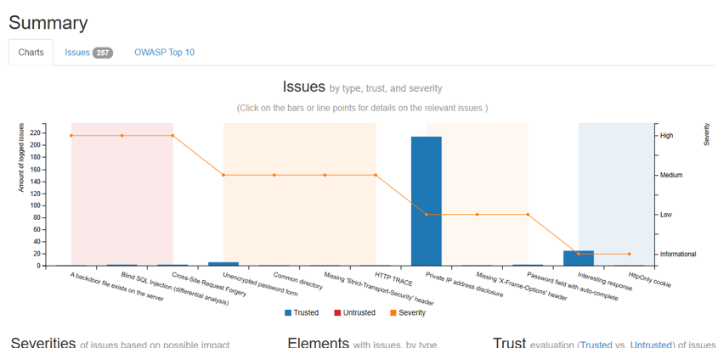
Some results generated by Arachni

Slide 11
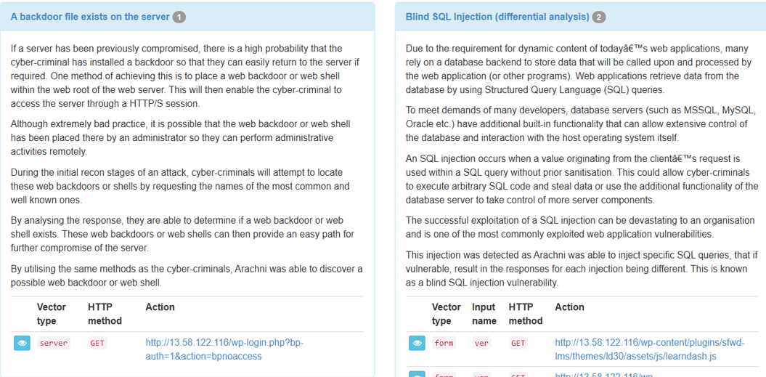

Slide 12
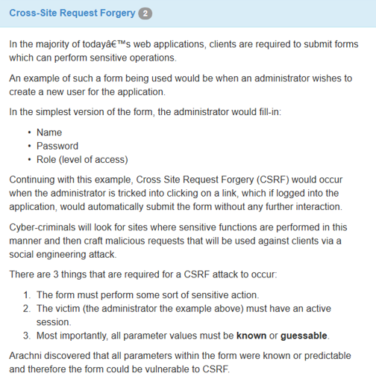

Slide 13
Part-II

Slide 14
Automation testing
Software Test automation makes use of specialized tools to control the execution of tests and compares the actual results against the expected result. Usually, regression tests, which are repetitive actions, are automated.
The automation software can also enter test data into the System Under Test, compare expected and actual results and generate detailed test reports. Test Automation demands considerable investments of money and resources.

Slide 15
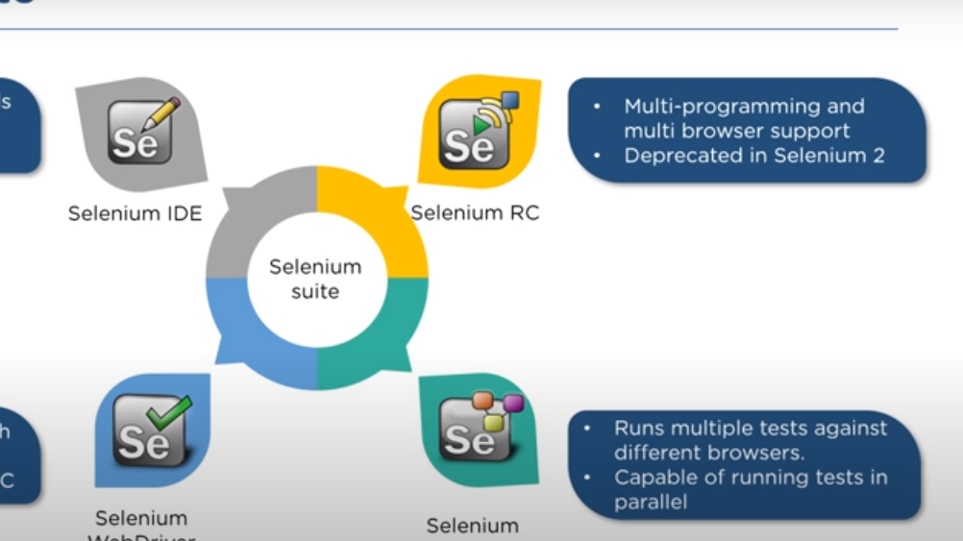
Selenium Suite

Slide 16
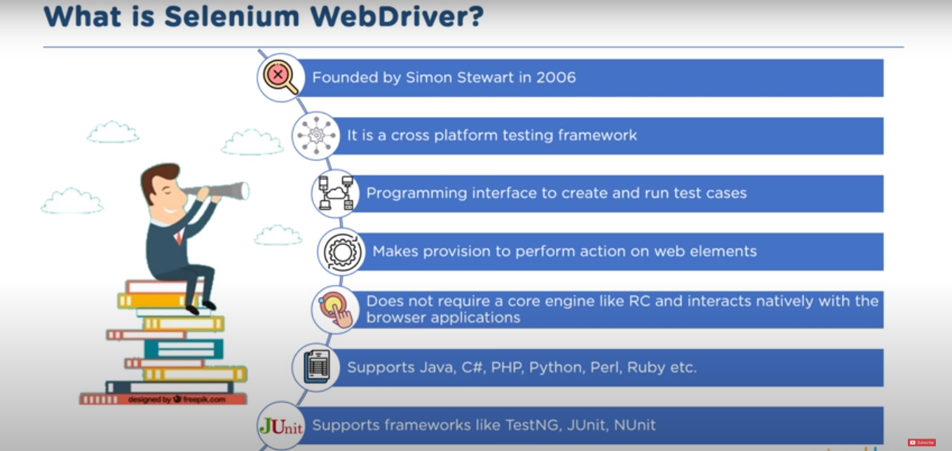

Slide 17
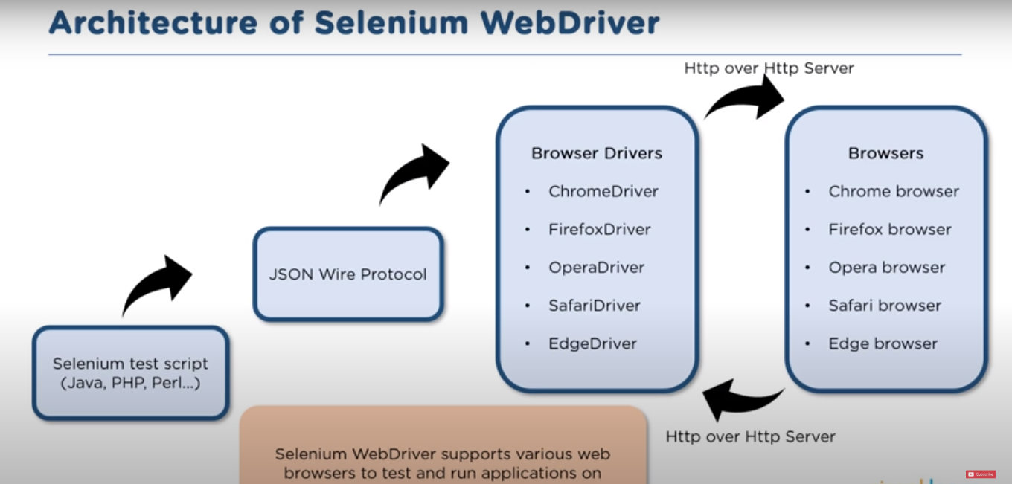

Slide 18
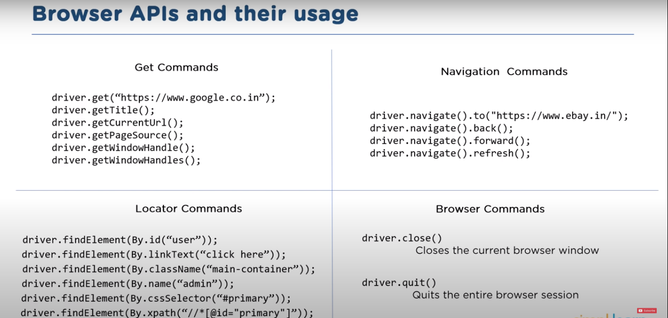

Slide 19



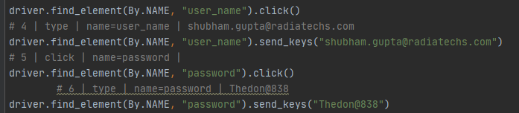
Some Code Snippets

Slide 20
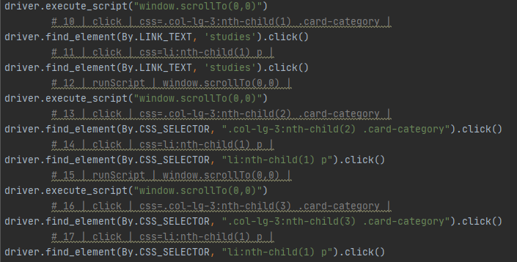

Slide 21
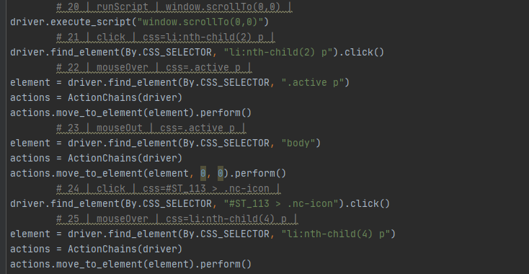

Slide 22
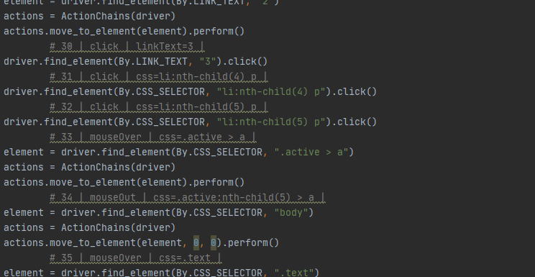

Slide 23
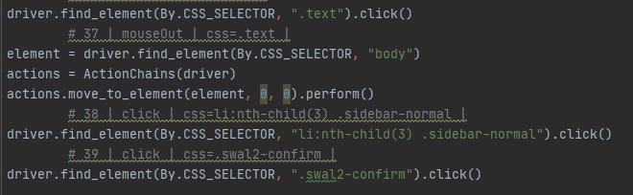

Slide 24
Future Scope
Making
Making the automation code scalable to be able to provide production support and making it easier for the support team to maintain the application in live environment.
Putting
Putting the code on a windows scheduler to execute it automatically at a given time in the day.

Slide 25
Learning From the Training
Testing various projects developed by the company gave me insights into importance of regression testing while developing the software. This assignment gave me the required insights to look at software development in a different perspective altogether.
Do What is Written and Write what you do.
Usability is as important as functionality.
Automation testing which helps save precious time from testing the already tested functionality again and again thus increasing the productivity and efficiency.

Slide 26

THANK YOU.

